Slide 1
Lifelong Data Science Report

Slide 2
Overview of Data

Slide 3
General Stats
3859 data points
Variables of interest:
Sex
Age Range
Race
Ethnicity
Housing Status
Case Management Agencies
Programs Enrolled/Services Received
Viral Load
Date of Last Primary Care Provider Visit
Date of Last Viral Load Test

Slide 4
Questions of Interest
How do demographics correlate with viral load, especially uncontrolled viral load?
How often do people visit their PCP without getting VL tested and vice versa?

Slide 5
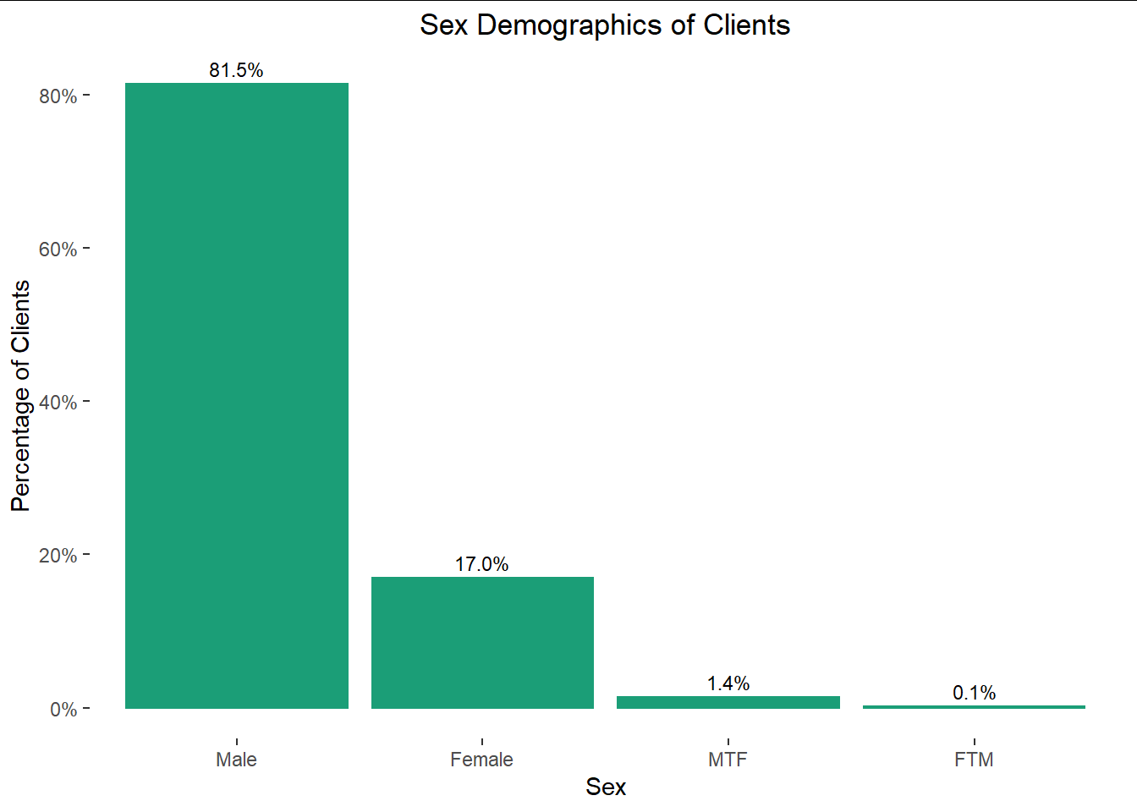
Sex
Most clients are cis men
Next highest demographic is cis female
More MTF trans people than FTM trans people which makes sense
Takeaways:
Keep unbalanced data in mind when analysing graphs that use gender

Slide 6
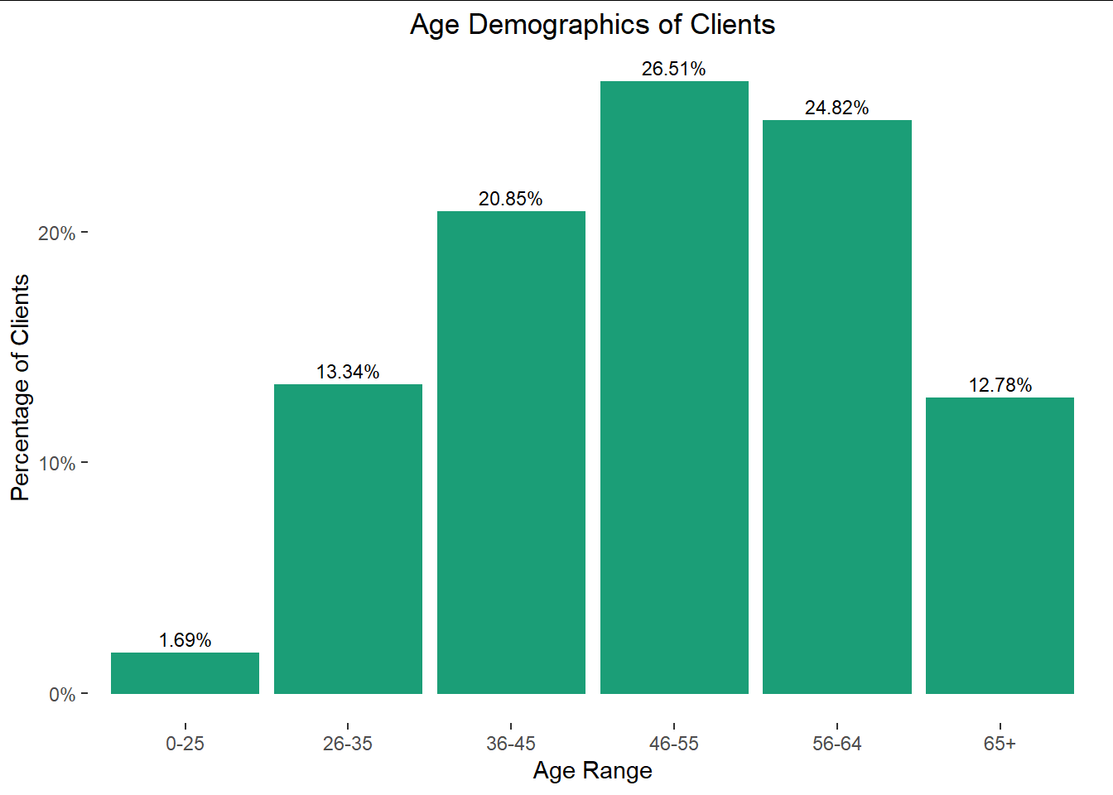
Age Range
Clients skew older
Few clients who are <25
HIV is often transmitted sexually. There are fewer sexually active people in that age range

Slide 7
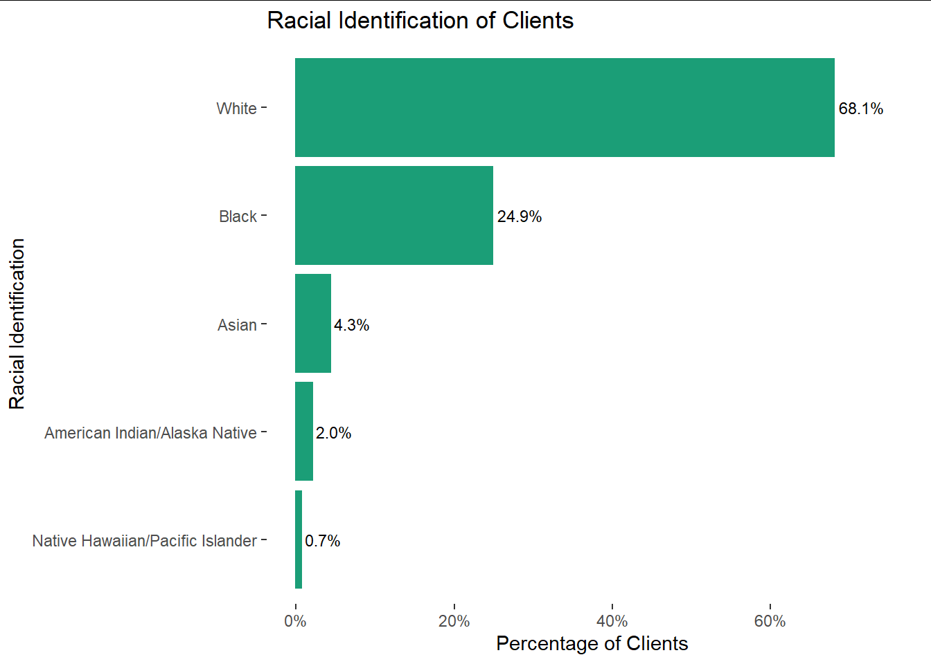
Race
Majority of clients are white
Second highest demographic is Black
Takeaway:
White people are represented proportionally to their population in Seattle
Black people are overrepresented (6.8% in Seattle)
Asian people are underrepresented (14.9% in Seattle)
Source: Seattle Census Data: https://www.seattle.gov/opcd/population-and-demographics/about-seattle#raceethnicity

Slide 8
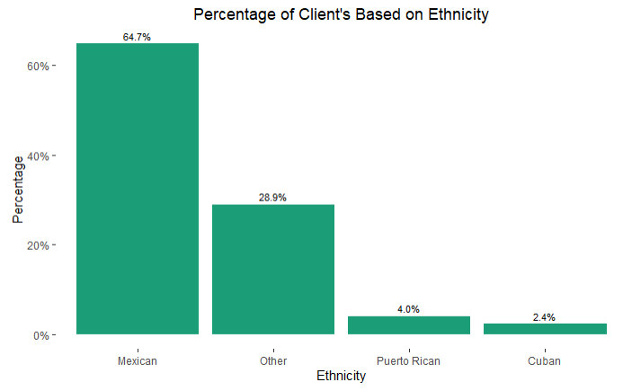
Ethnicity
Most clients are non-Hispanic (83% non-Hispanic, 17% Hispanic)
Most Hispanic clients are Mexican
Takeaways:
Hispanic clients are overrepresented (6.6% of Seattleites are Hispanic)
Source: Seattle Census Data: https://www.seattle.gov/opcd/population-and-demographics/about-seattle#raceethnicity

Slide 9
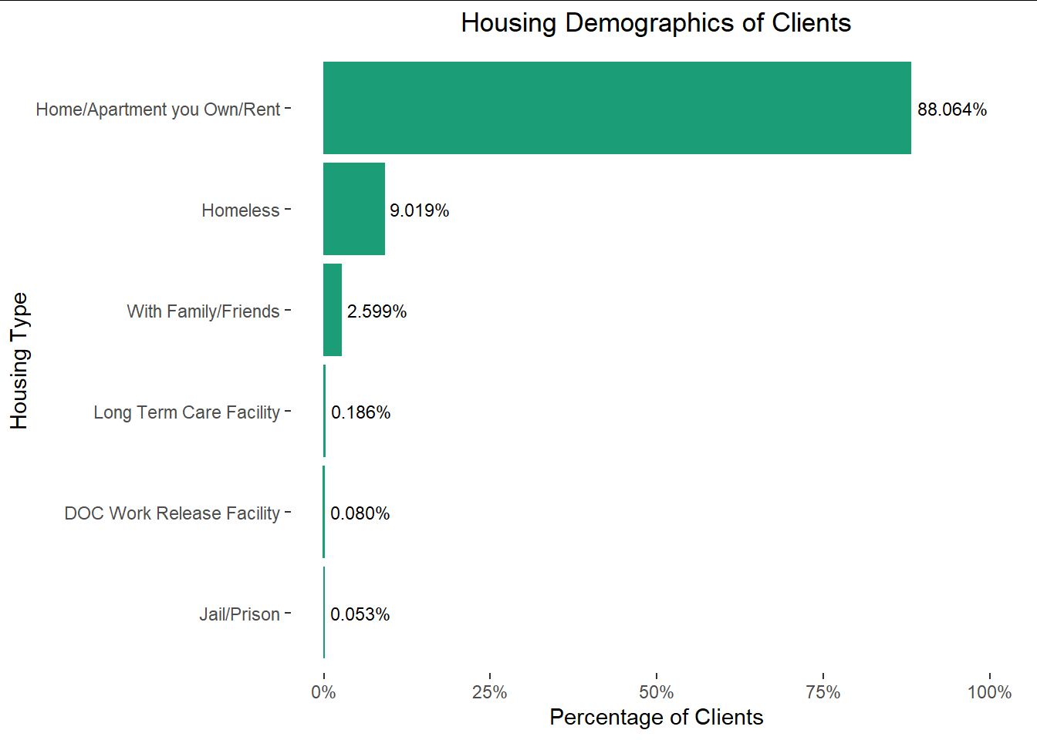
Housing Status
Most clients live in houses/apartments that they own/rent
Homeless clients are overrepresented in the data compared to average Seattle homelessness rates
9% here, 1% in Seattle
Source: Seattle Times: https://projects.seattletimes.com/2021/project-homeless-data-page/

Slide 10
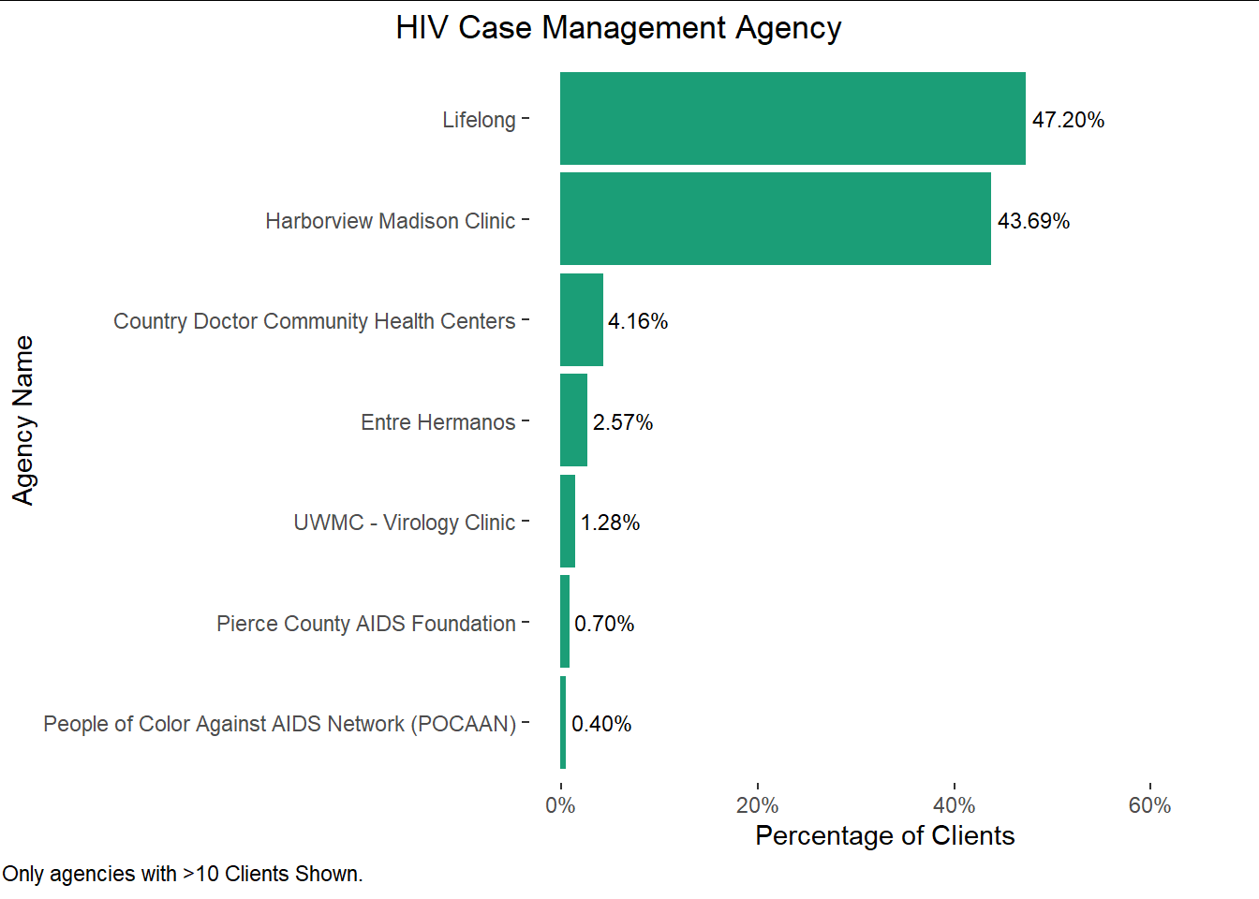
Case Management Agencies
Most clients are served by Lifelong or Harborview Medical Clinic
Many case management agencies have fewer than 10 clients
This visualization does not include those but the visualizations are available if requested

Slide 11
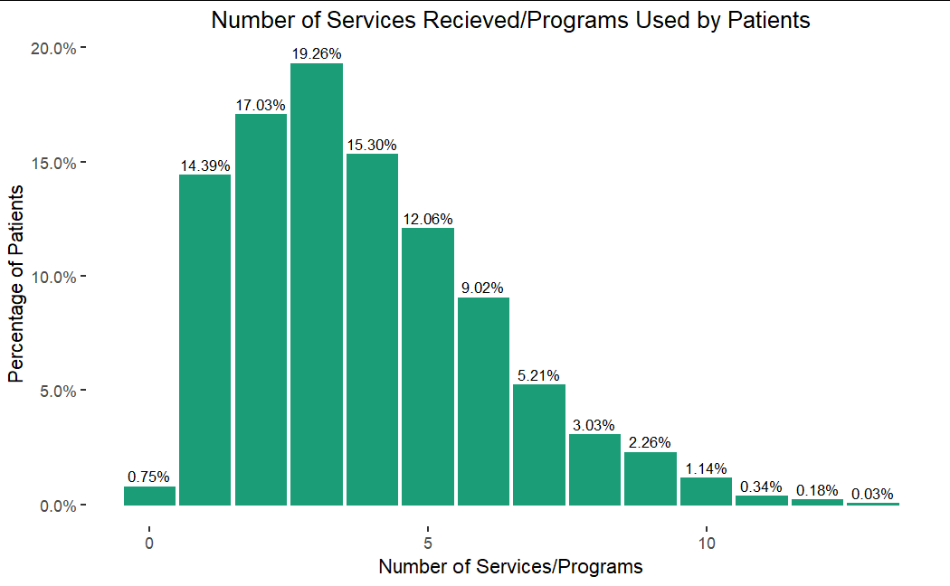
Programs Enrolled/Services Received
The majority of clients in this data set receive/use ~3 services or programs. The next highest percentage uses 2, while the third highest receives 4. Important to note that once number of services or programs are greater than 5, the percentages drop rather quickly.

Slide 12
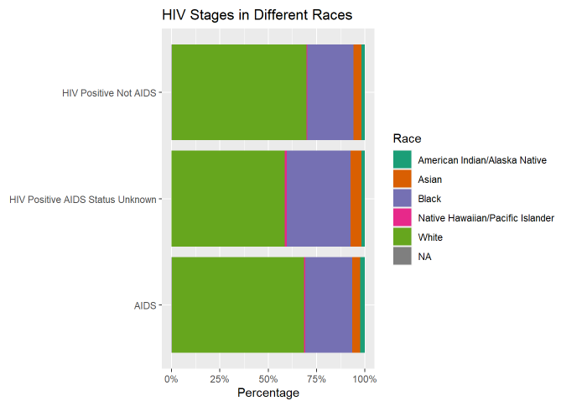
Race and HIV Stage
Majority of clients are white with over 50% for all three HIV/AIDS stages
Second highest demographic are black
Overrepresented in the data, compared to Seattle demographics
https://www.seattle.gov/opcd/population-and-demographics/about-seattle#raceethnicity

Slide 13
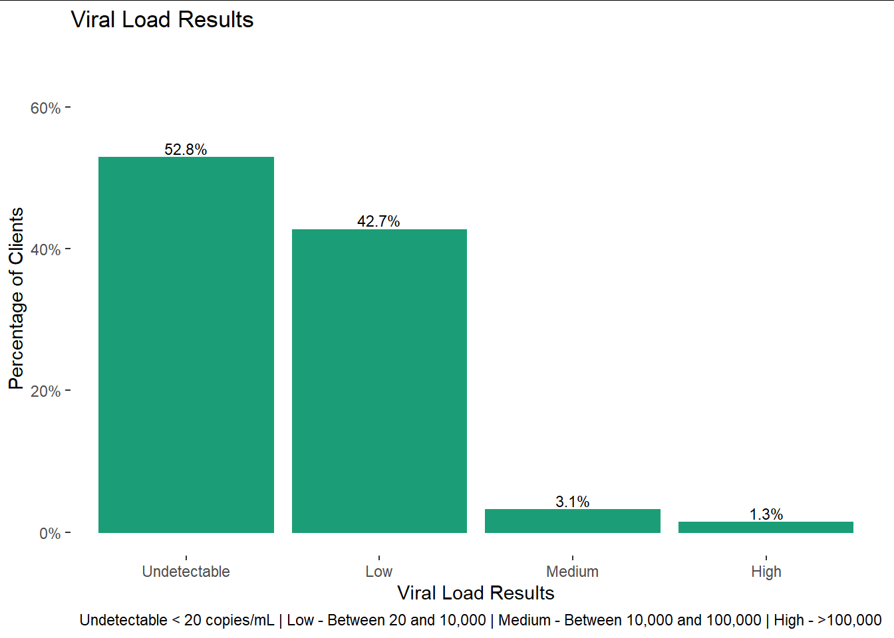
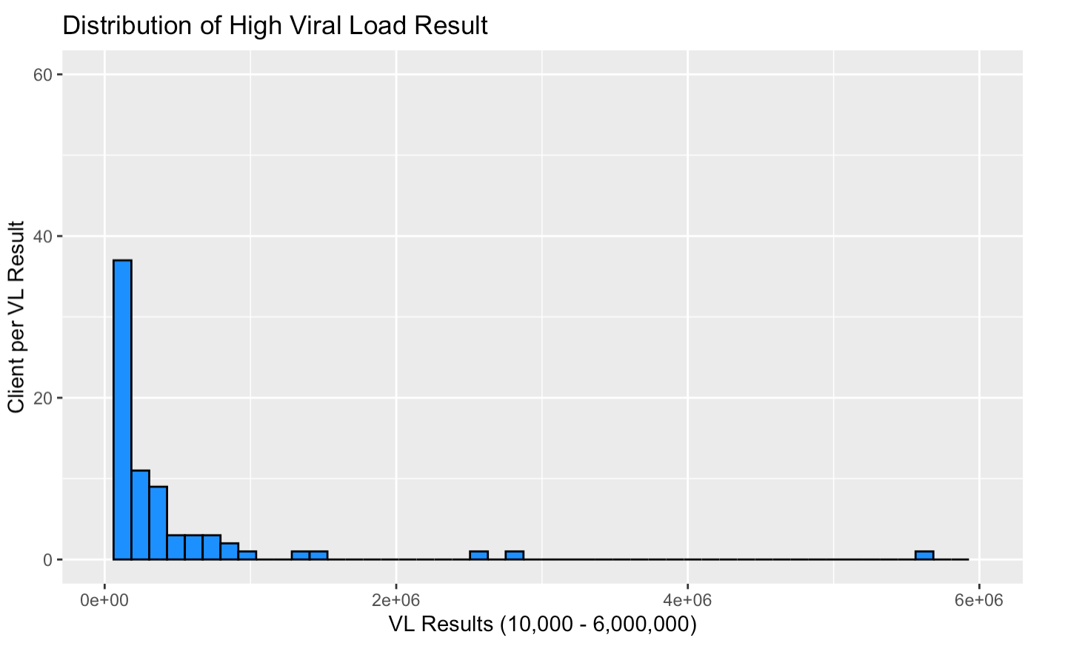
Viral Load
VL Results are heavily clustered towards a lower Viral Load
More than 90% of the clients have a VL lower than 10,000
Around 89% of the clients have a VL lower than 100

Slide 14
Viral Load Analyses

Slide 15
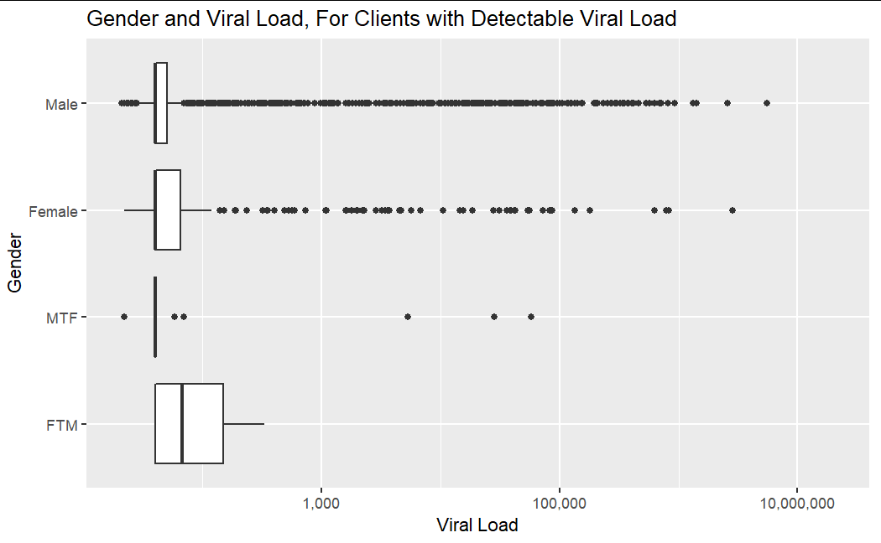
Gender and Viral Load
Note that this graph uses a log scale on the y-axis, so the small differences in height mean a lot
The vast majority of clients have VL < 100,000

Slide 16
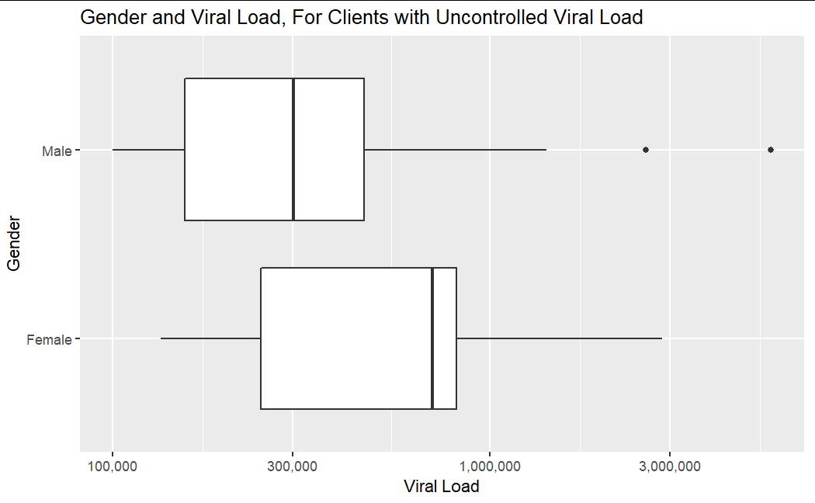
Gender and Uncontrolled Viral Load
13.7% female and 86.3% male
Compare to distribution of all clients:

Slide 17
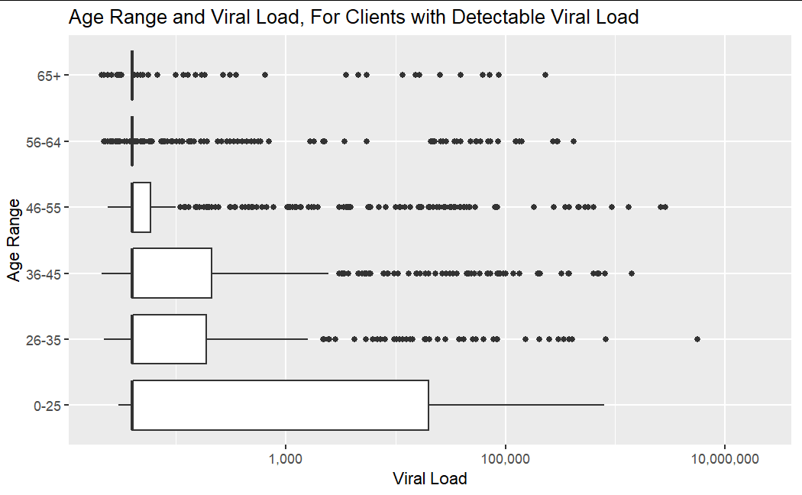
Age Ranges and Viral Load
VL varies more the younger a client is
All age ranges have the same low averages
The older clients get, the less variation in VL there is.
There are more clients in older age ranges

Slide 18
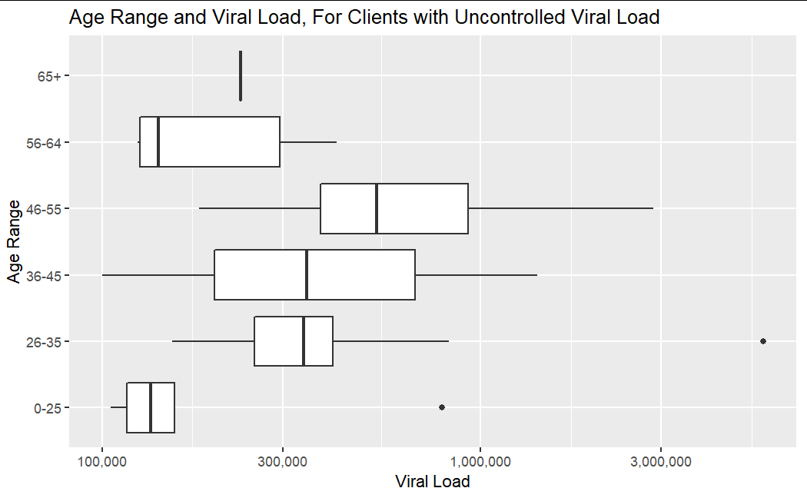
Age Ranges and Uncontrolled Viral Load
Clients who are 36-55 show the most variability
65+ age range only includes 1 data point
While 0-25 age range has a lot of variability (seen in last slide), they have the lowest VL counts of the uncontrolled set

Slide 19
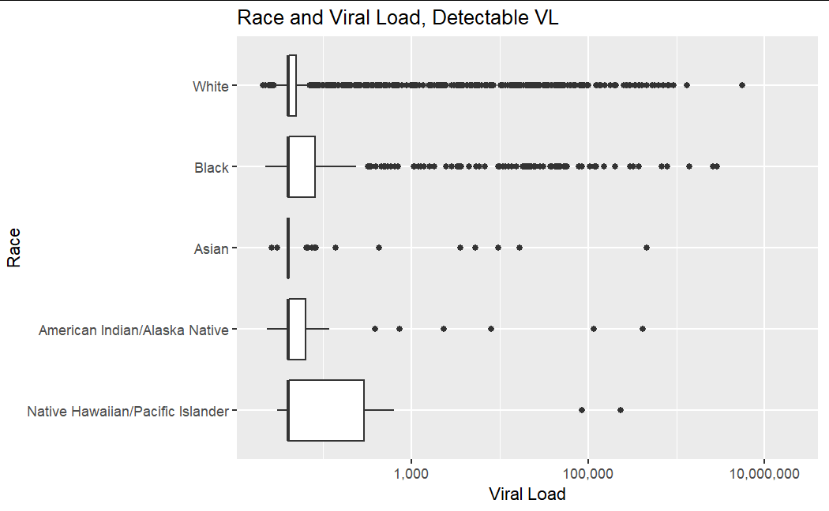
Race and Viral Load
In this graph, the middle quartile/median is very similar for all racial identifications.
White and Black races have significantly more outliers past Q4 than NH/PI, Asian, and AI/AN races. This is because there are significantly more white and Black identified clients than the other races.

Slide 20
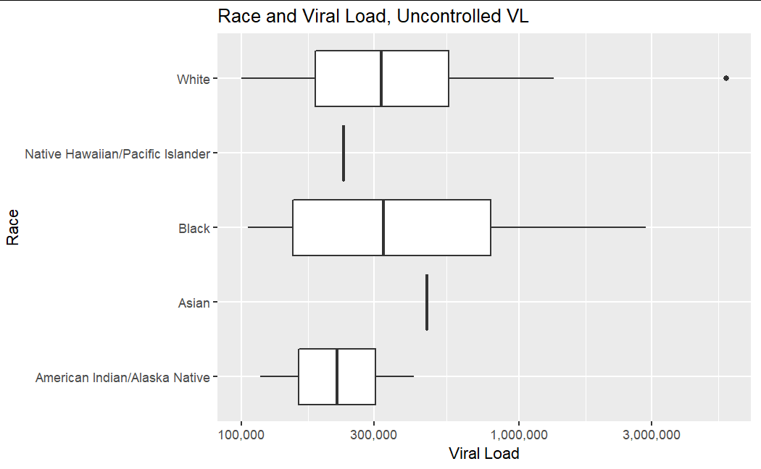
Race and Uncontrolled Viral Load
Only 1 datapoint in this set in the Asian category, 1 in NH/PI, 2 in AI/AN
Black clients have more variability in VL
Black and White clients have about the same average

Slide 21
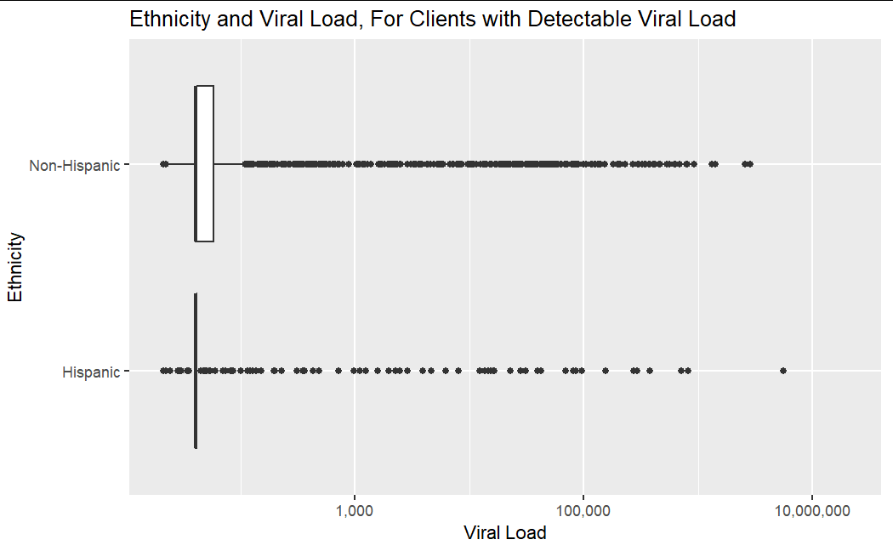
Ethnicity and Viral Load
Majority of the clients are non-Hispanic; this group has a larger distribution of viral loads. Hispanic individuals have the same median range which indicates majority of Hispanic clients have as average the same detectable Viral Load as compared to the majority of their non-Hispanic counterparts.

Slide 22
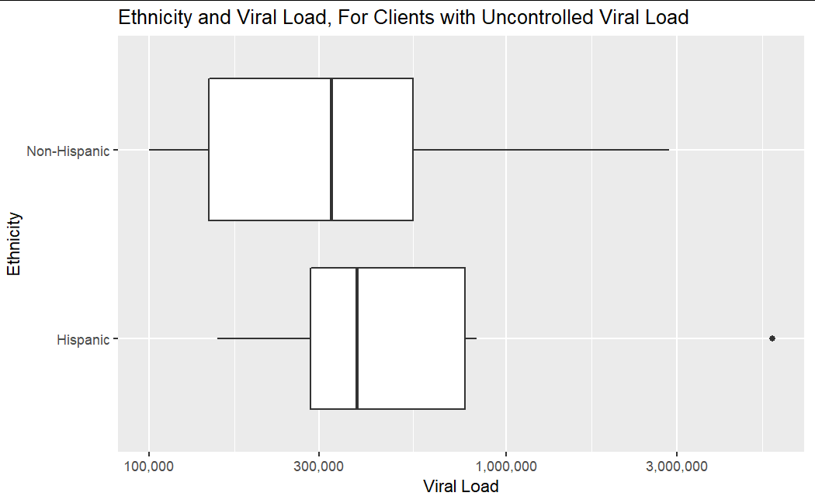
Ethnicity and Uncontrolled Viral Load
Majority of the clients are non-Hispanic; this group has a larger distribution of viral loads. Hispanic individuals have a higher median and inter-quartile range which indicates majority of Hispanic clients have higher viral loads as compared to the majority of their non-Hispanic counterparts.

Slide 23
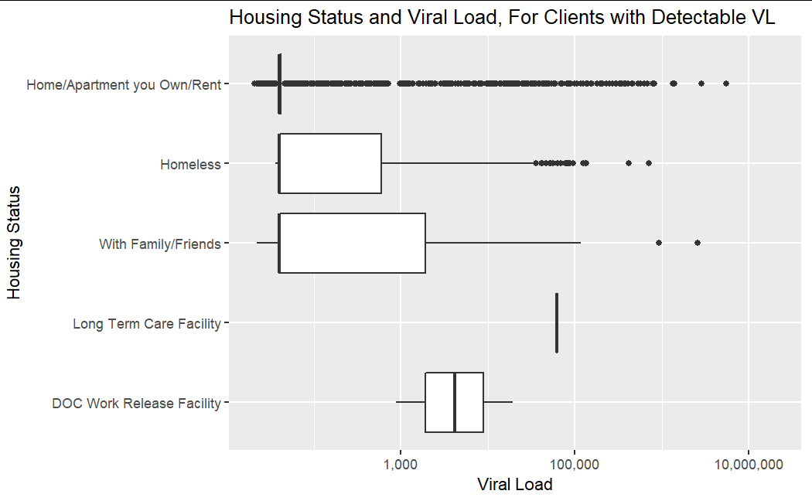
Housing Status and Viral Load
While Homeless, Apartment, and Living with Family present large outliers, it is clear that those living with other people, such as friends and family, have generally tested for higher viral loads overall.
This data is partially proportional to the amount of points in the data set, and could be part of the reason for this correlation.

Slide 24
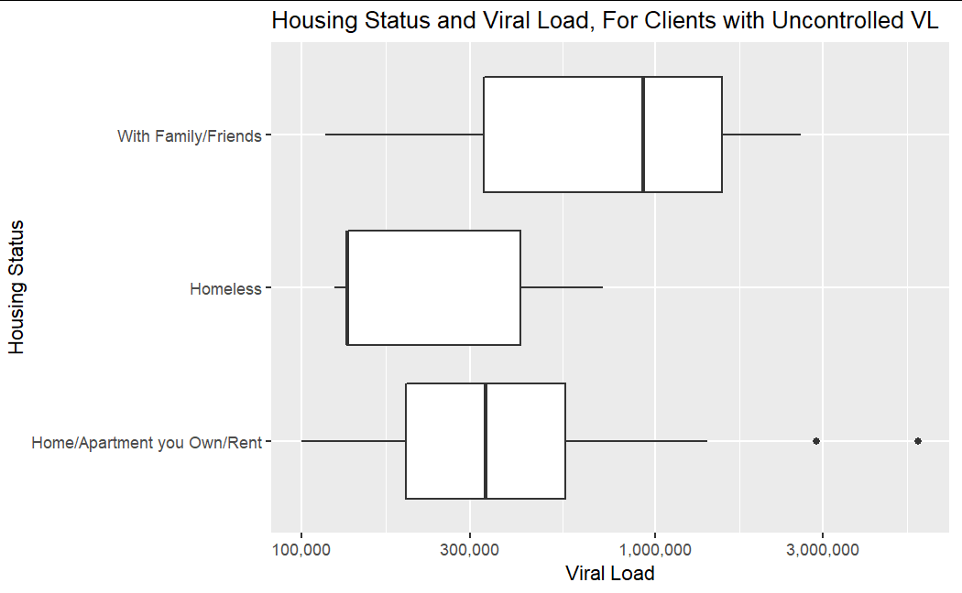
Housing Status and Uncontrolled Viral Load
Similar to the controlled Viral load, it appears that those more frequently exposed to people closely have higher general viral loads. Here, the variability of the Family/Friends category to be much wider than where people who own/rent.

Slide 25
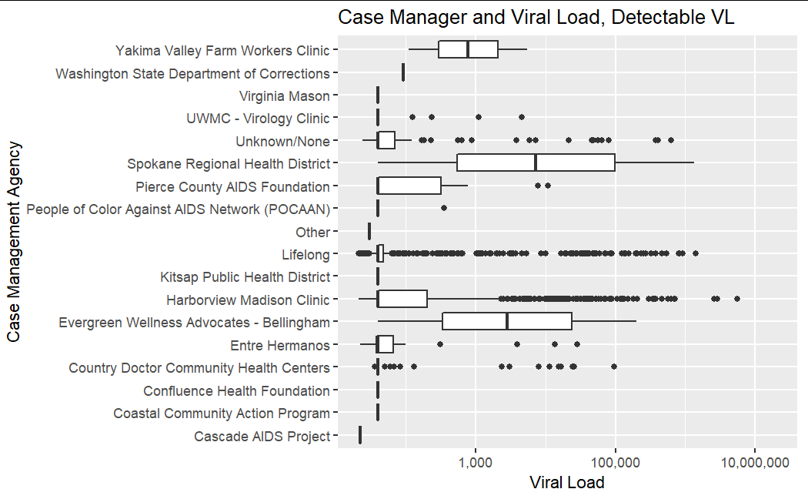
Case Management Agencies and Viral Load
From this graph, we can understand that Lifelong and Harborview Madison Clinic have the most outliers past its Q4. An explanation for this is that these two agencies have the most clients out of the rest, meaning their box plots contain a significant amount of data points compared to the rest of the agencies in the dataset

Slide 26
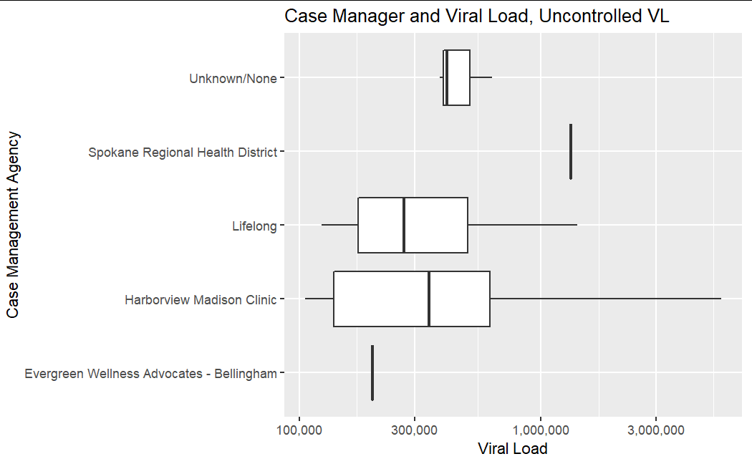
Case Management Agencies and Uncontrolled Viral Load
Lifelong and Harborview Madison Clinic both have the largest distribution in terms of the viral load size of their clients. Harborview services clients with the lowest and highest viral loads. Lifelong services the second largest group of clients, however, support individuals with a lower viral load than Harborview.

Slide 27
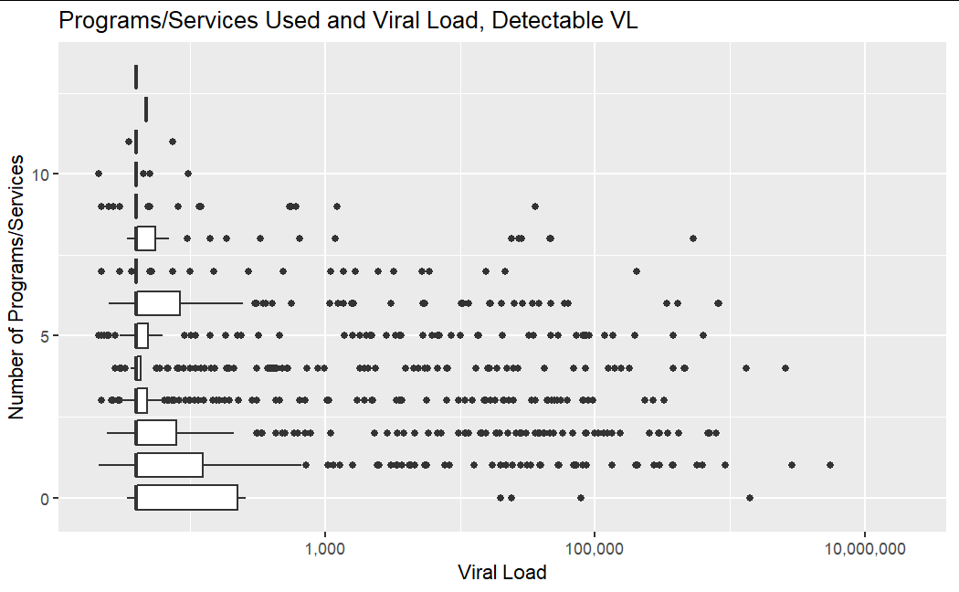
Programs/Services and Viral Load
The clients with the highest viral loads tend to use fewer services

Slide 28
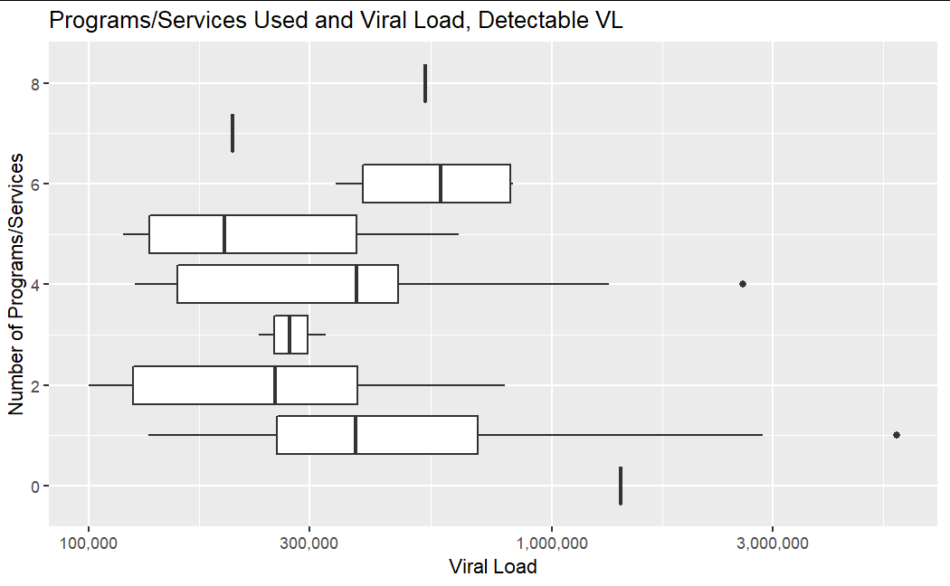
Programs/Services and Uncontrolled Viral Load
Outliers include people that used 7 or 8 services, and people that used 0
Like in the full set of clients with detectable VLs, clients who use 1-2 services show the most variability in VL.

Slide 29
PCP Visits and VL Tests

Slide 30
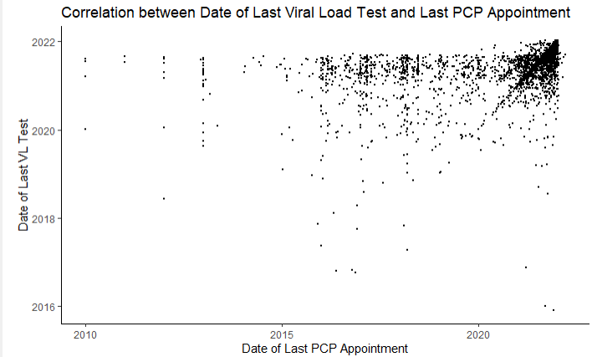
Data of Last PCP Visit and Date of Last Viral Load Test
Most clients did their last VL test after 2020, with a small amounts not having a VL test since 2016.
Most clients who had VL tests in recent years (Last 1-2 years) have also had a PCP check-up in the same amount of time.
Some clients who have had a VL test in the recent years (Last 1-2 years) have not had a PCP check-up in the past 1-2 years.
vertical lines mean that people are not going to the doctor but continuing to get VL tested

